Slide 1

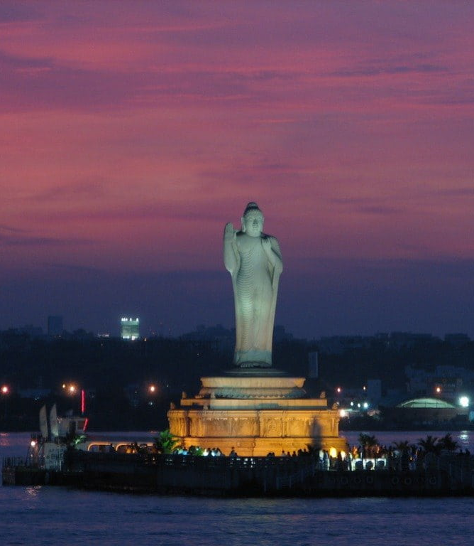


GROWTH ANALYSIS OF TELANGANA
By
Neelesh M

Slide 2


Agenda
Introduction
Objective
Transportation Analysis
TS – Ipass Analysis
Stamp Analysis
Secondary Research and Insights
Research Questions

Slide 3
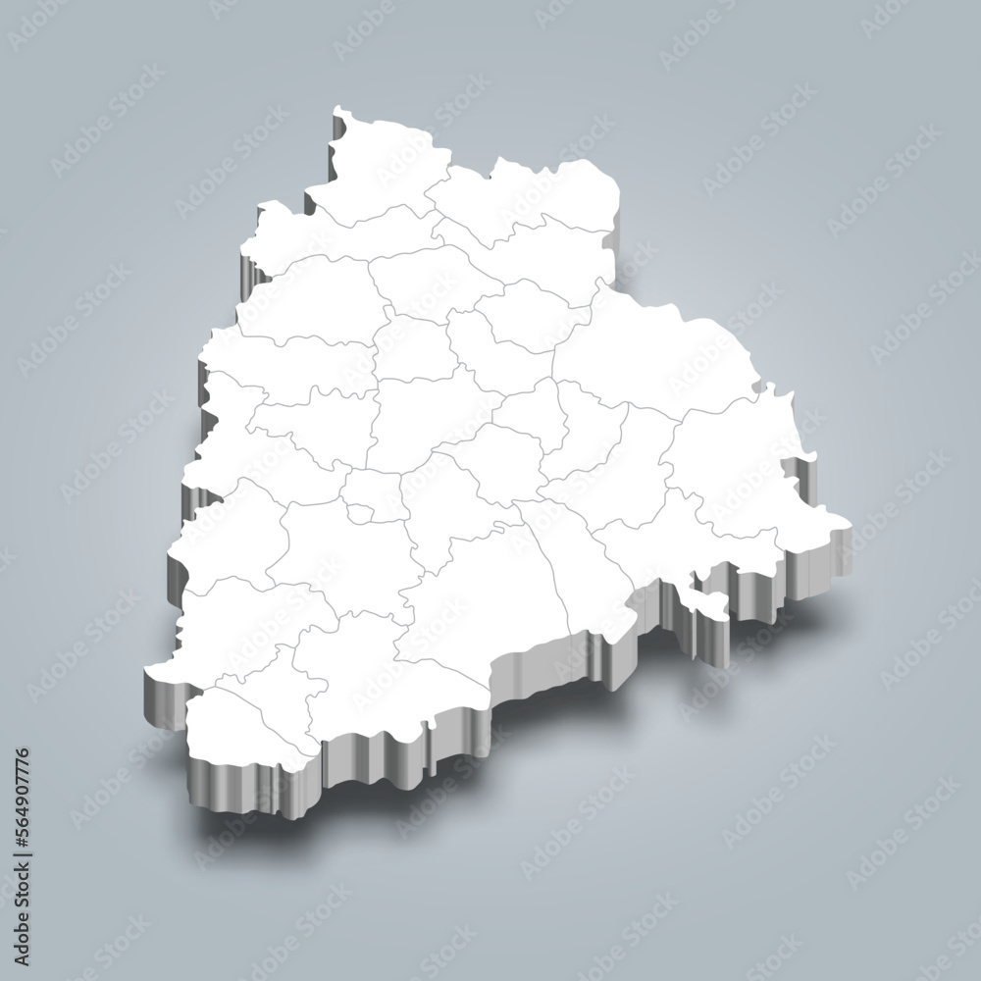
Introduction
Telangana is the 29th state of the country, formed on 2 June 2014 by the partition of Andhra Pradesh. Hyderabad is the capital and largest city of Telangana.
Telangana has a diverse economy, with agriculture, industry, and services sectors all playing important roles. The state is home to a number of major industries, including pharmaceuticals, information technology, and textiles.
Telangana is the 11th largest state in India by economy, with a GSDP of ₹9.76 lakh crore (US$130 billion) in 2021-22. The state's per capita GSDP is ₹2.43 lakh (US$3,200), which is higher than the national average.
With it’s open data policy we can analyze growth across various sectors and provide insights to Telangana Govt.
3

Slide 4
To help PETER PANDEY – The DATA ANALYST for his Portfolio Project on Real time data doing the following tasks : Examine the Datasets given from OPEN DATA TELANGANA on Stamp registration, Transportation and TS-iPass across all districts. Understand their attributes and analyze trends and patterns within each department. Visualizing the data which can provide clear insights in the given sectors. Finding correlation among the departments and report the overall growth of the state.
Objective
4

Slide 5


E-STAMPS- E-Stamp duty in Telangana-Assessment, Management & Payment System refers to the stamp duty, transfer duty, registration fees and user charges paid by the public to register any deed. User now has the convenience of paying the stamp duty from anywhere. This system is user friendly, hassle free and helps to get rid of Duplicates. It’s a complete online and Fool proof system which reduces the manual process and documentation where payments can be made accurately where the acceptability of multiple challans for a single document. This helps the government tracking the revenue up to date in stamp registration Transactions.
e – Stamp Registration

Slide 6
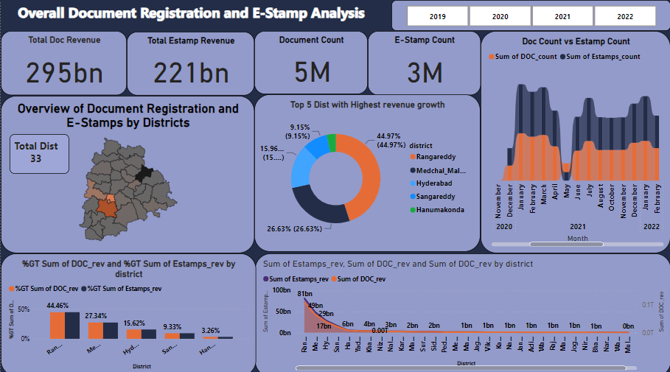

Slide 7
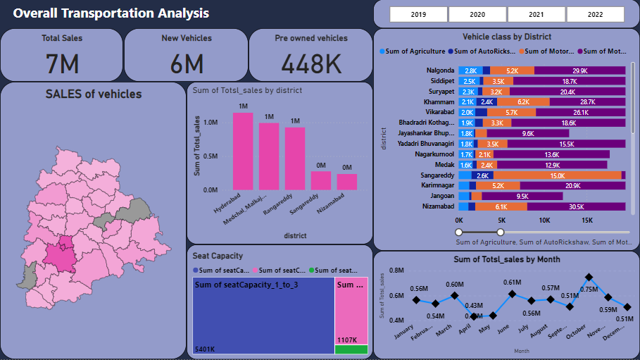

Slide 8
TS-IPASS --Telangana State Industrial Project Approval and Self-Certification System is a certification system that provides support to industries, services, manufacturing companies in Telangana. It is an online process that helps to clear certificate on process and permissions within short timelines.. It was created to increase the swiftness of application and certificate clearance process for industrial units that are proposed for the new state. The TS-Ipass Act shall boost the Investments to increase the number of investors to set up industrial units.
TS – Ipass
&
Investment

Slide 9
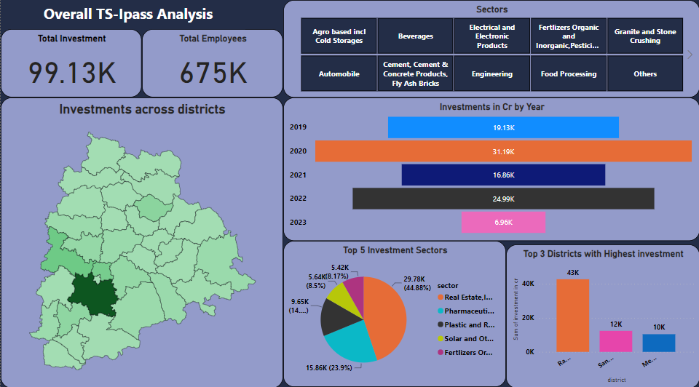

Slide 10
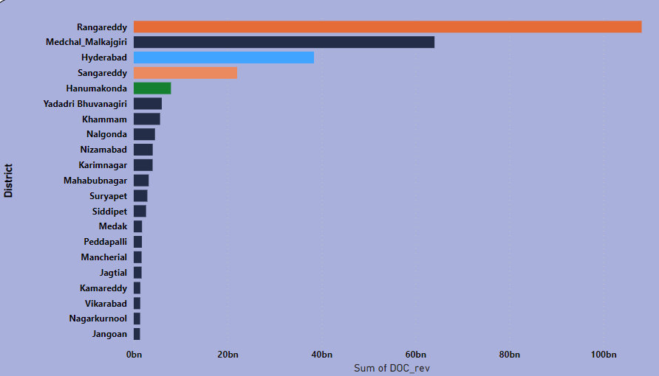
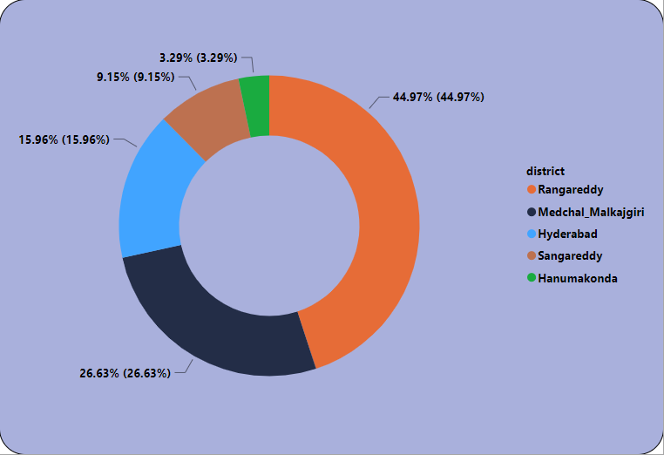
How does the revenue generated from document registration vary across districts in Telangana? List down the top 5 districts that showed the highest document registration revenue growth between FY 2019 and 2022 ?

Slide 11
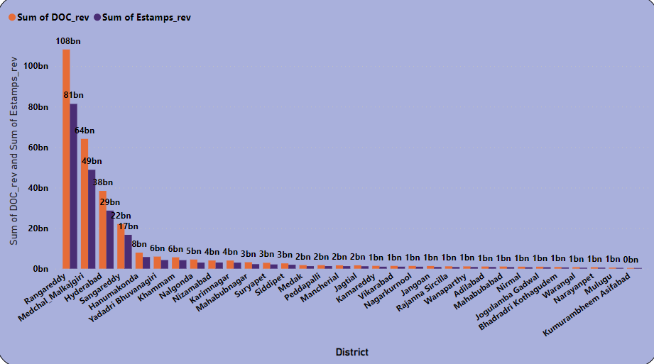
How does the revenue generated from document registration compare to the revenue generated from e-stamp challans across districts? List down the top 5 districts where e-stamps revenue contributes significantly more to the revenue than the documents in FY 2022?

Slide 12
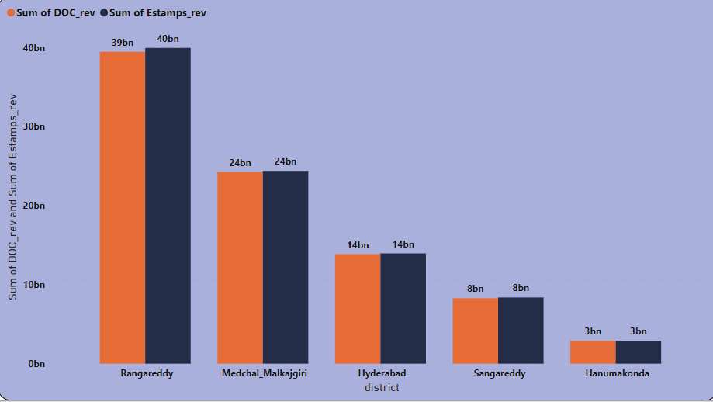
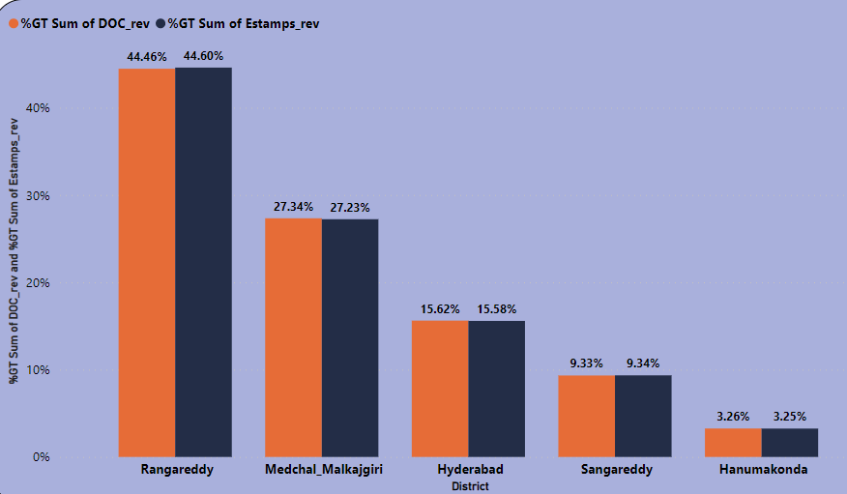
Districts with E Stamp revenue more than Document registration revenue

Slide 13
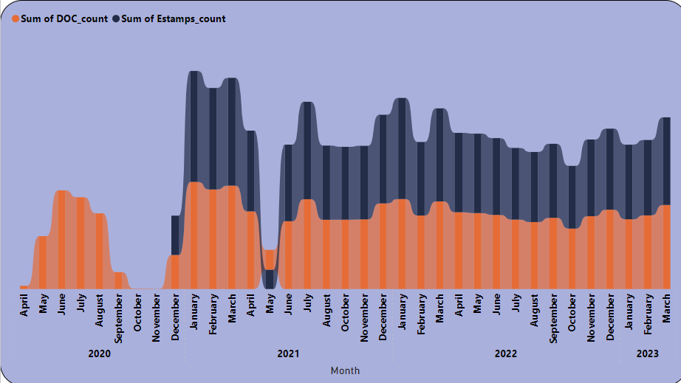
Is there any alteration of e-Stamp challan count and document registration count pattern since the implementation of e-Stamp challan? If so, what suggestions would you propose to the government?
So, we can observe from the above analysis that E-stamp challan count is more than document registration count since it’s inception in 2020, which suggests that some people prefer an online and easy process while document registration count is normal in its path.

Slide 14
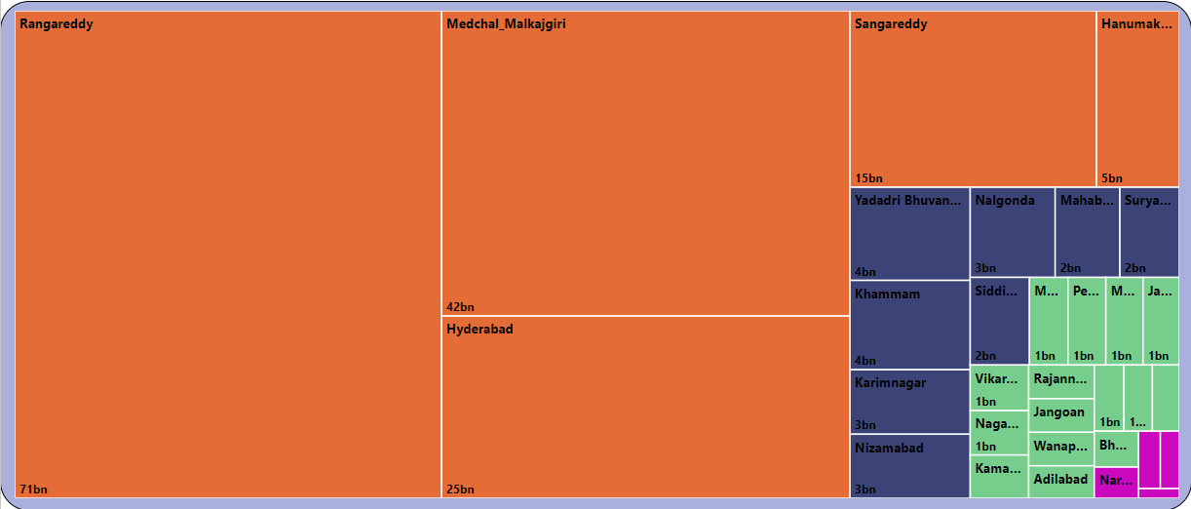
Categorization districts into three segments based on their stamp registration revenue generation during the fiscal year 2021 to 2022.

Slide 15
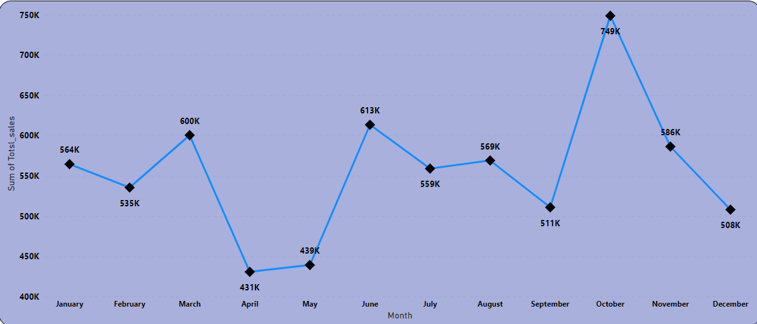
Investigate whether there is any correlation between vehicle sales and specific months or seasons in different districts. Are there any months or seasons that consistently show higher or lower sales rate, and if yes, what could be the driving factors ?
From the above observation the sales factor in the month of October is high and the lowest is in the month of April

Slide 16
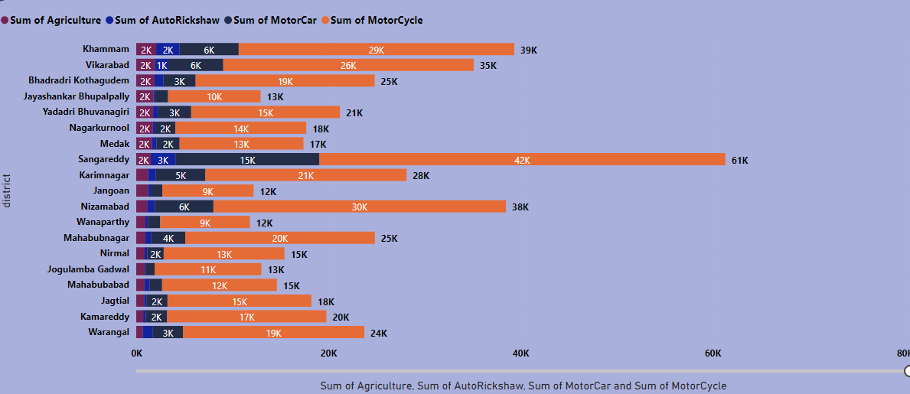
How does the distribution of vehicles vary by vehicle class (Motorcycle, Motorcar, Autorickshaw, Agriculture) across different districts? Are there any districts with a predominant preference for a specific vehicle class?
Considering FY 2022 analysis.
From the analysis we can observe that major sales was for Motorcycle followed by Motor car.

Slide 17
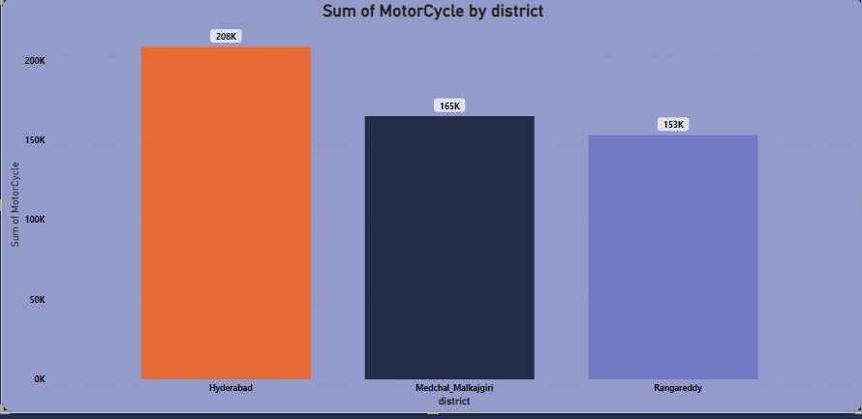
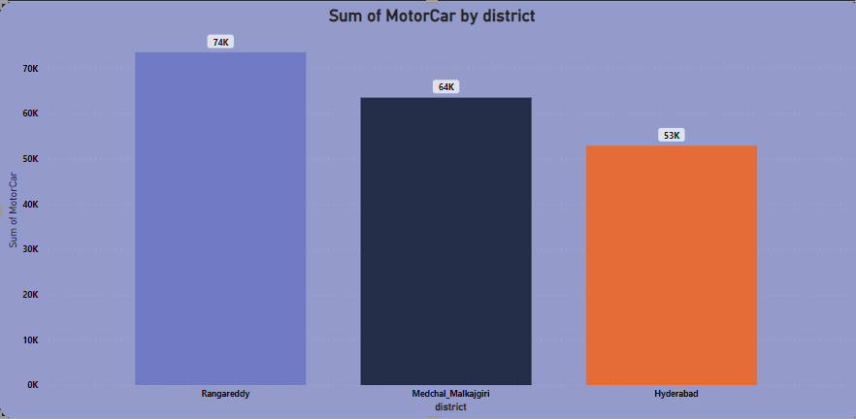
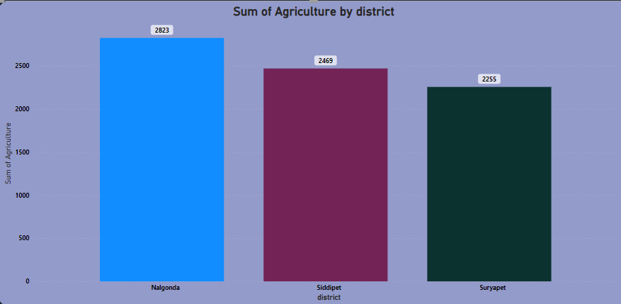
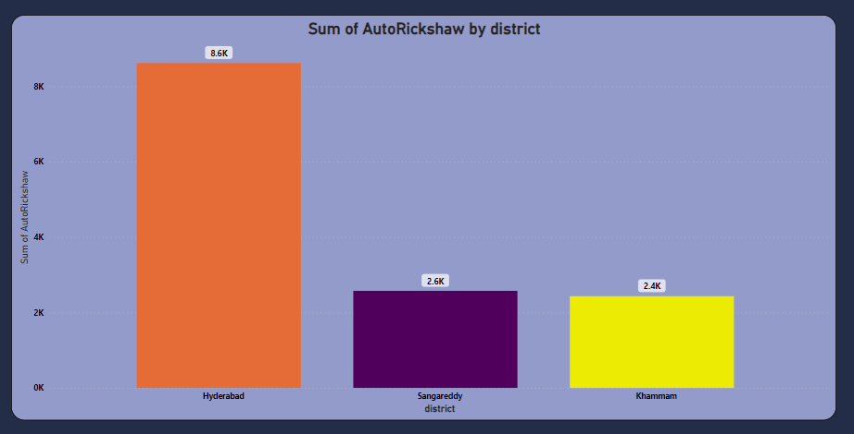

Slide 18
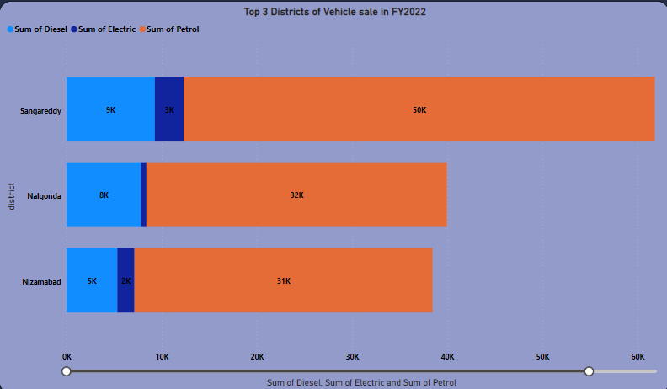
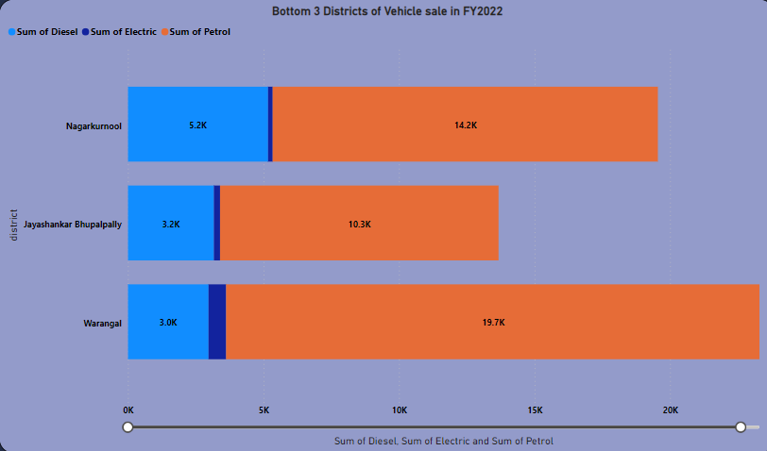
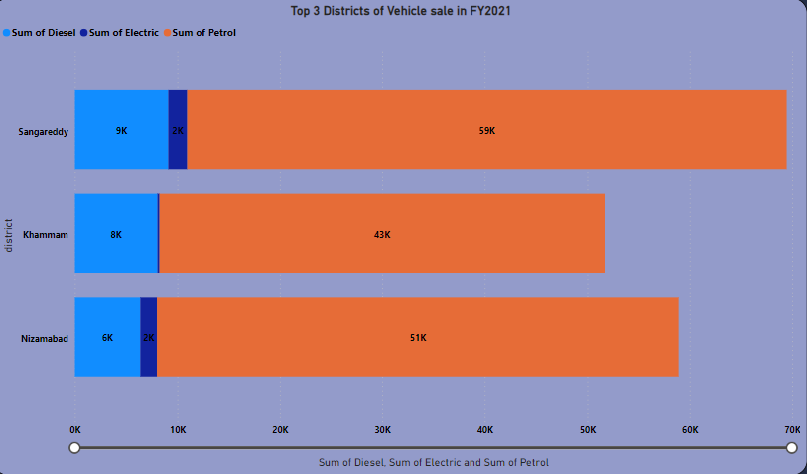
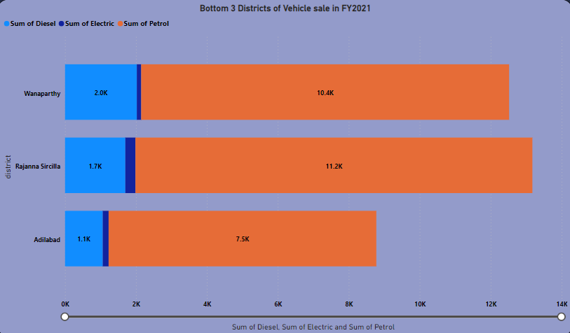
List down the top 3 and bottom 3 districts that have shown the highest and lowest vehicle sales growth during FY 2022 compared to FY 2021? (Considering and comparing categories: Petrol, Diesel and Electric)

Slide 19
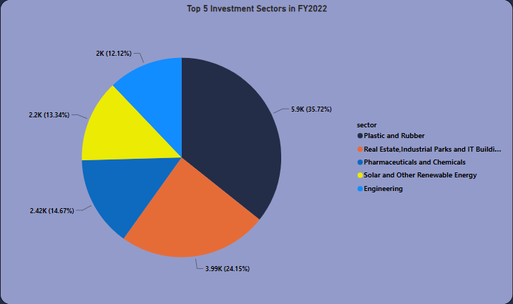
Listing down the top 5 sectors that have witnessed the most significant investments in FY 2022.

Slide 20
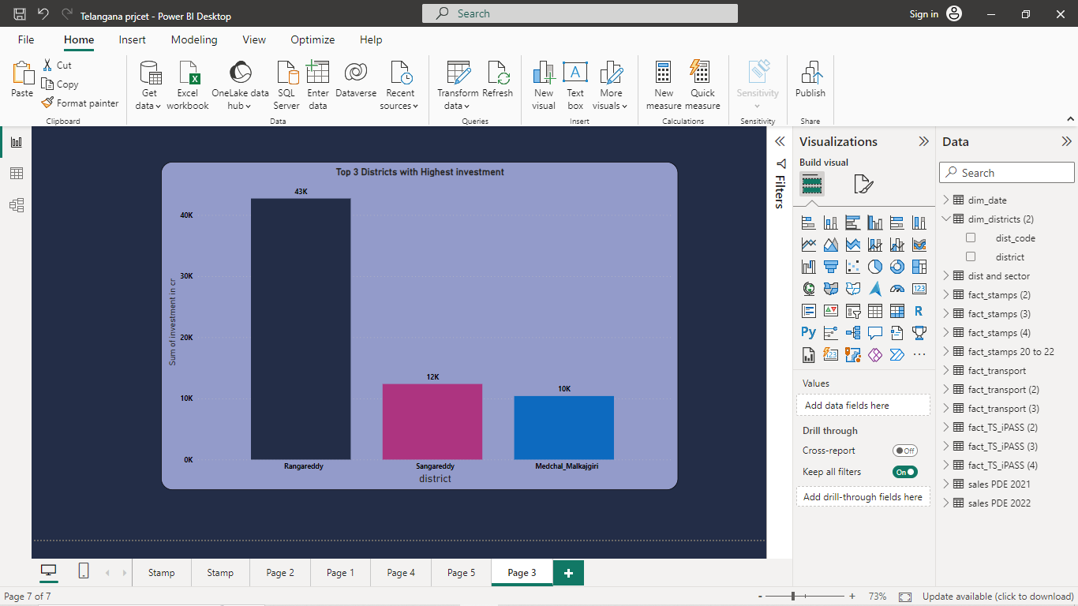
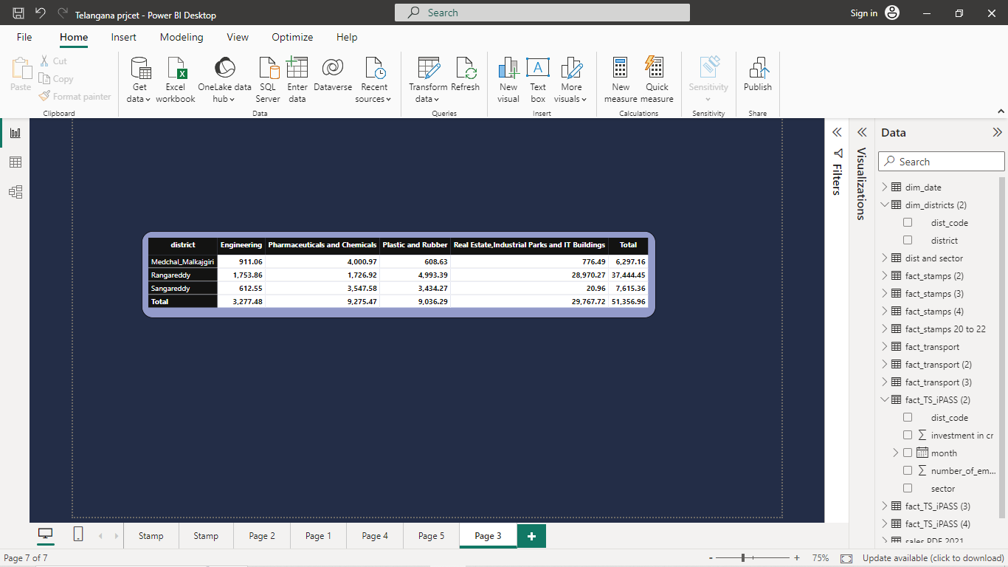
List down the top 3 districts that have attracted the most significant sector investments during FY 2019 to 2022? What factors could have led to the substantial investments in these particular districts?

Slide 21
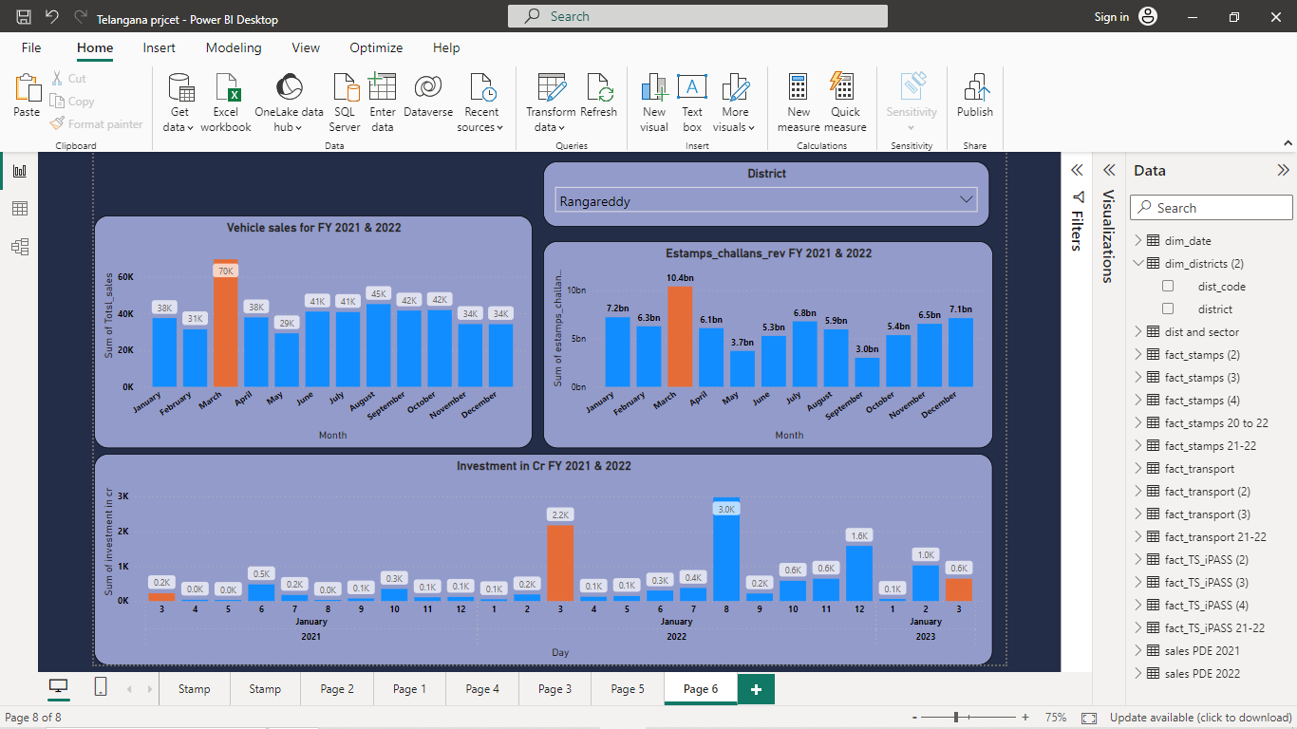
Is there any relationship between district investments, vehicles sales and stamps revenue within the same district between FY 2021 and 2022?

Slide 22
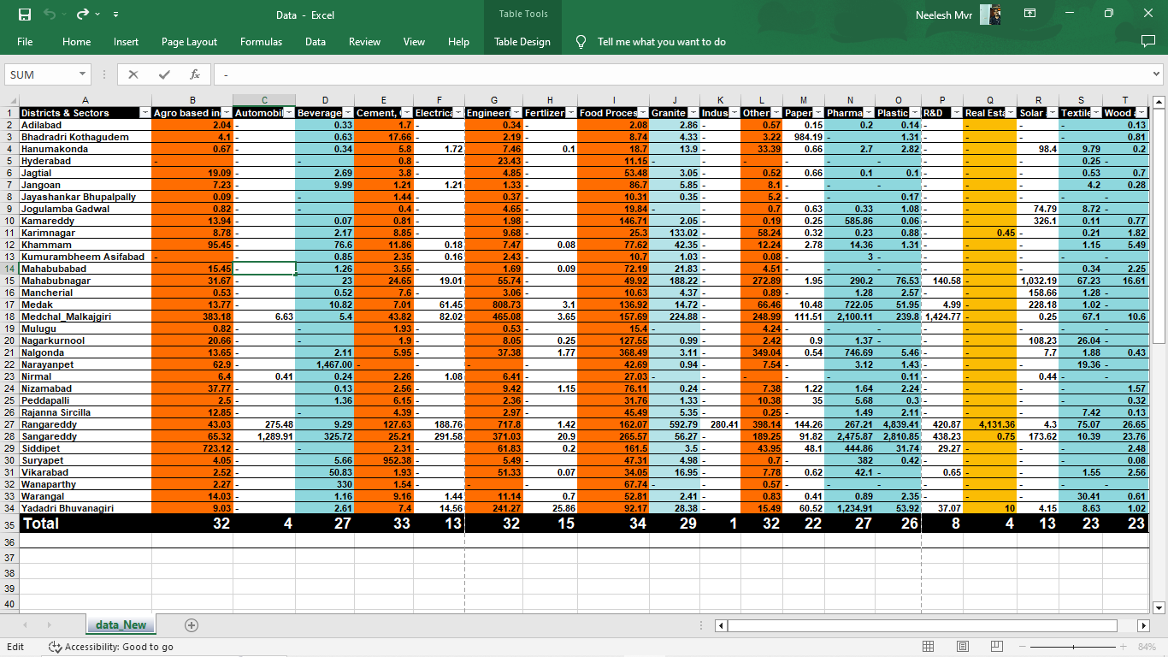
Are there any particular sectors that have shown substantial investment in multiple districts between FY 2021 and 2022?
From the above analysis the sectors FOOD PROCESSING, AGRO BASED INDUSTRIES, CEMENT INDUSTRIES, ENGINEERING, GRANITE, PHARMAUTICALS, PALSTIC AND RUBBER sectors invested in multiple districts while REAL ESTATE sector invested huge investments in few districts.

Slide 23
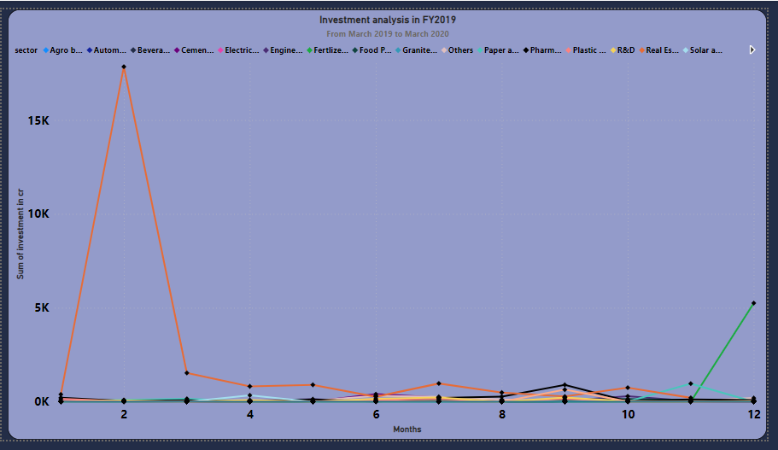
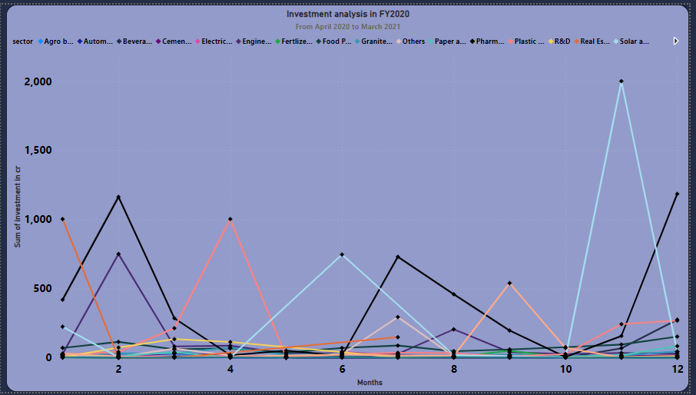
Can we identify any seasonal patterns or cyclicality in the investment trends for specific sectors? Do certain sectors experience higher investments during particular months?

Slide 24
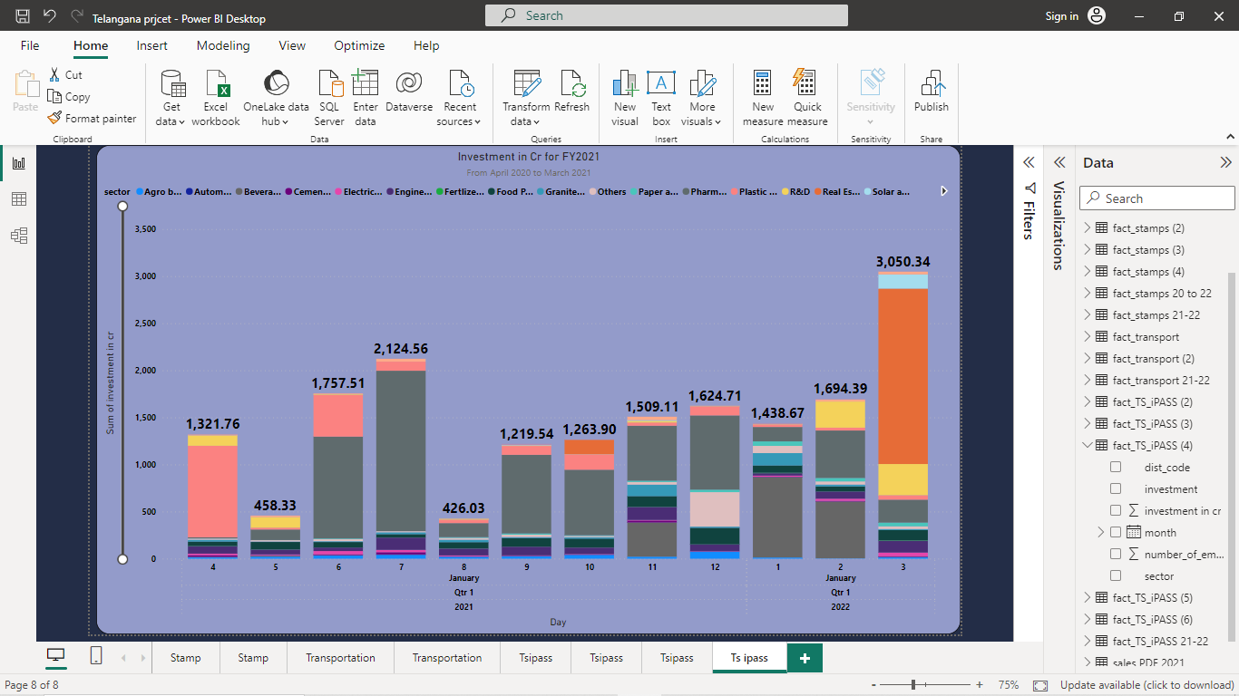
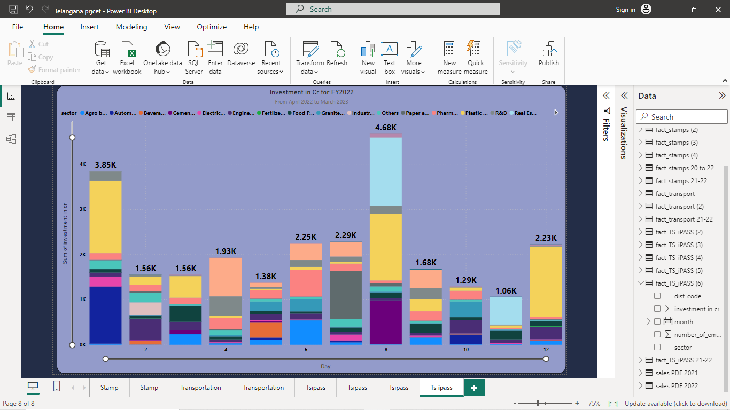

Slide 25
From the above observation we can find that FY2019 -- The high investments of Real estate sector is especially in Q1 and Fertilizer in Q4. Remaining sectors are moderate. FY2020 – During Q1 Pharma, Engineering, Food processing and Plastic & rubber sectors were of high investments, In Q2 Solar energy sector is high with Pharma again increasing in Q3, While in Q4 the Solar energy sector surges high with pharma being second highest. FY2021 -- Q1 has more investments from Plastic & rubber sector followed by Pharma. In both Q2 & Q3 Pharma sector dominates the others up to starting of Q4. In Q4 Real estate sector’s investment is high followed by pharma. FY2022 – In Q1 Plastic sector is of high investment followed by automobile.Q2 is moderate in all sectors while in Q3 both Plastic & rubber and Real estate sectors has high investments. Q4 is nominal with Plastic sector investment high.
25

Slide 26
Secondary Research
What are the top 5 districts to buy commercial properties in Telangana? Justify your answer.
Rangareddy
Hyderabad
Medchal Malkajgiri
Sangareddy
Warangal
Hyderabad is fastest developing capital in India with its ease of doing business and with IT as its main income and welcoming international companies and also tourism attraction.
Rangareddy is nearer district to Hyderabad so it has the feasibility to use the resources of Hyderabad.
Medchal Malkajgiri as it’s one of largest constituencies in India with its near area of Secundrabad, which is yet another developed area with high population and Industrial areas.
Sangareddy has more educational institutions and industrial area named Pathancheruvu which consist of many Pharma industries.
Warangal is developing IT hub after Hyderabad in Telangana which also has NIT, and many industries and also famous for tourism as its historical OORUGALLU with UN heritage recognized monuments.

Slide 27
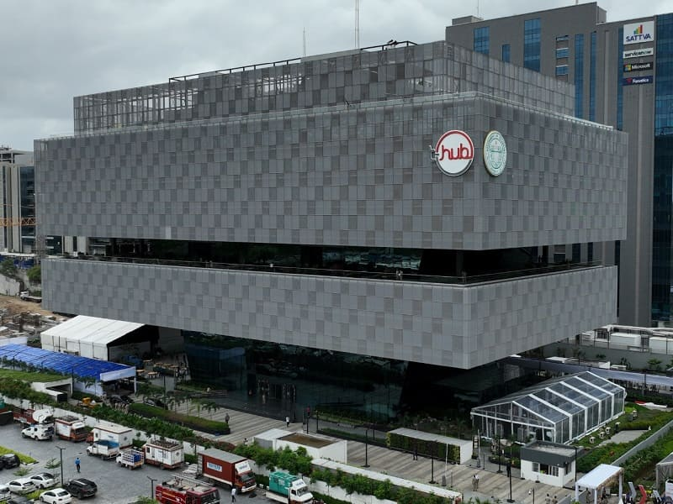
Policies of Telangana : Main Motive of INNOVATE .. INCUBATE .. INCORPATE
Mission Bhagiratha
TS-ipass
Global linker
TS - IDEA
Industrial corridors (Hyd – Warangal)
Special Investment zones
Vehicle subsidy schemes for driver empowerment
Pharma city
T – Food processing society
Special economic zones (67)
T – HUB
ESDM ( Electronics system design policies)
Rythu Bandhu
EV & Power electronics industries

Slide 28
Insights
TS govt is very much focused in speeding process and providing sources for the industries with it’s diverse policies
It has favorable investment climate with its own EASE of doing business policies.
Hyderabad is heart of the city where every development task stars here.
T – policy making in industrial and infrastructure sectors pushes the state to grow rapidly.
It became the IT destination of India surpassing other competitive cities.
Digitization is playing a crucial role.
Recommendations
Regarding EV it’s beneficial if it has special policies other than on going in Hyderabad which helps reducing other type of vehicles.
The Major development and revenue generation area of Telangana is Hyderabad and other districts surrounding it. Incentivizing investments in rural areas and empowering the people with digitization there will be very helpful for this state for balanced growth.
Tourism sector plays a crucial role in any development, Infra building for the destination attract more and generates revenue.
It has diverse resources which will help developing R & D sector which boosts investment, and skill training to all helps the employers to employee development by not depending on other state people.

Slide 29
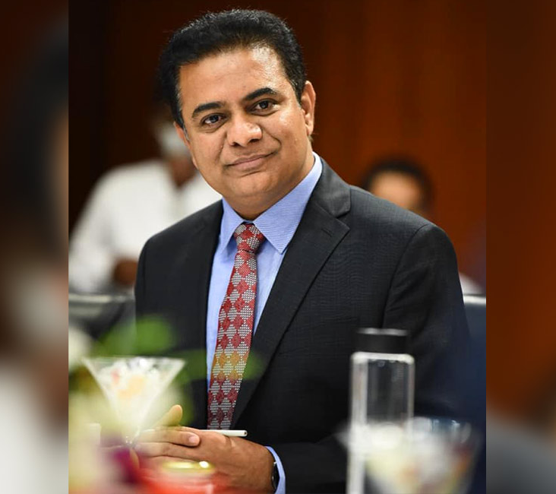
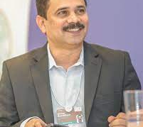

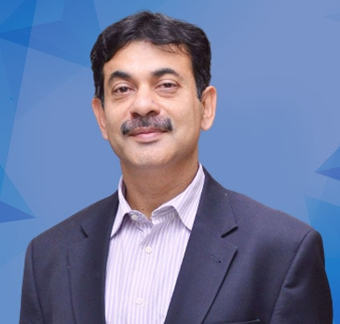
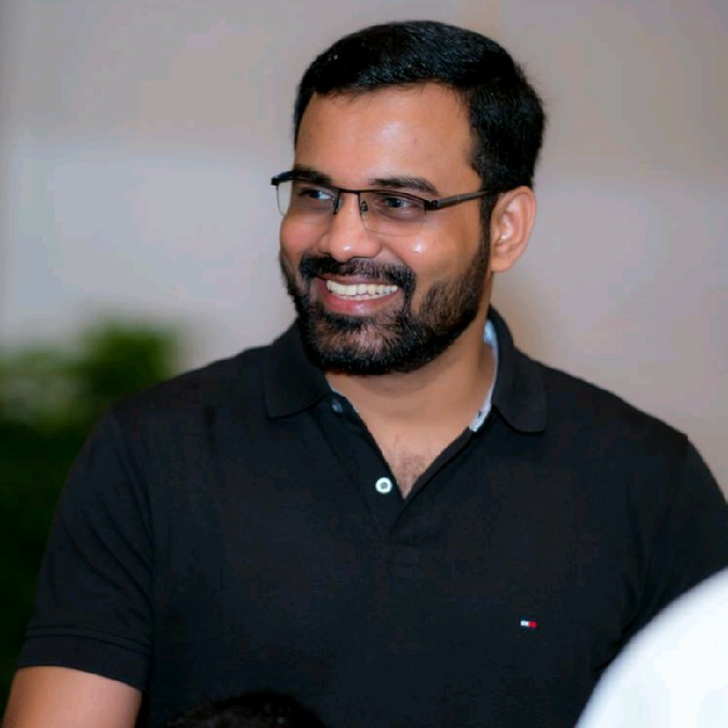
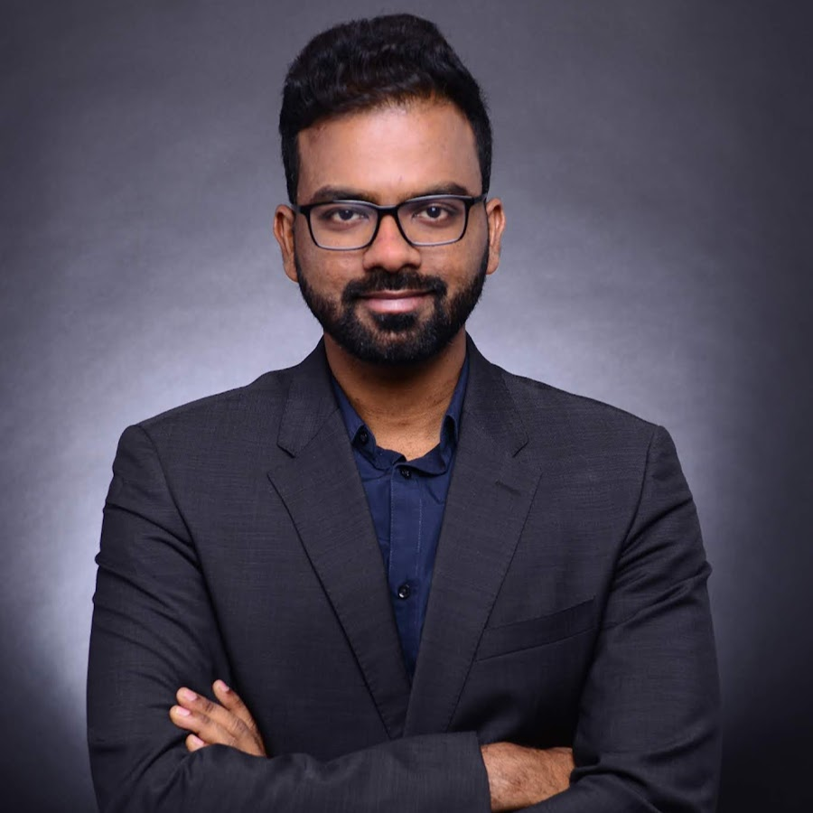
Thanks to the Stack holders & Team Code basics
Kalvakuntla Taraka
Ramarao (KTR)
Minister of IT, Industries and Municipal Administration
Dileep Konatham
Director at Govt of Telangana
Dhaval Patel
Founder, Code basics
Venu Panjarla
Open data Telangana
Hemanand Vadivel
Co-founder, Code basics
Jayesh Ranjan
Secretary, Information Technology (IT)
Govt of Telangana
29

Slide 30

Thank You
30

